Slide 1
Quality Attributes
Understanding Quality Attributes
Availability, Interoperability, Modifiability, Performance, Security, Testability, Usability
Other Quality Attributes

Slide 2
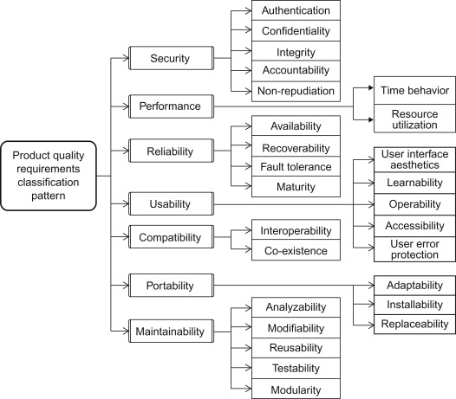

Slide 3
Understanding Quality Attributes
System requirements can be categorized as:
  Functional requirements- system tasks, reaction to run-time stimuli.
  Quality attribute requirements- annotate (qualify) functional requirements.
  Constraints- decision with zero degree of freedom (e.g., screen size)

Slide 4
Understanding …
Functionality
  is the ability of the system to do the work.
  has a strange relationship to architecture:
    functionality does not determine architecture- unlimited architectural choices to satisfy it.
    functionality and quality attributes are orthogonal

Slide 5
Understanding …
Quality attribute (QA)
  Consider the below functional requirement
  "when the user presses the green button, the Options dialog appears”:
  QA annotation might describe:
    performance - how quickly the dialog will appear
    availability - how often it will fail/how quickly repaired
    usability - how easy it is to learn this function.

Slide 6
Understanding …
Specifying QA requirements
  We use a common form to specify all QA requirements as scenarios.
  QA scenarios are represented in parts:
    Source of stimulus- entity (e.g., human or computer system) that generated the stimulus.
    Stimulus- a condition that requires a response when it arrives at a system.
    Environment- stimulus occurs under certain conditions (e.g., overload condition or in normal operation).
    Artifact- some artifact is stimulated like the whole system, or some pieces of it.
    Response- activity undertaken as result of arrival of the stimulus.
    Response measure- the response should be measurable so that the requirement can be tested.

Slide 7
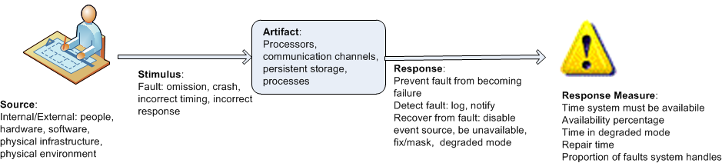
Understanding …
Specifying QA requirements …
  Example general scenario for availability:

Slide 8
Understanding …
Achieving QA through tactics
  There are a collection of primitive design techniques that an architect can use to achieve a quality attribute response.
  Such design primitives are called tactics.
  Tactics, like design patterns, are techniques that architects have been using for years. We do not invent tactics- architects practice.

Slide 9
Understanding …
Achieving QA through tactics …
  There are three reasons for using tactics:
    Design patterns are bundle of design decisions (complex) often difficult to apply as is, hence they are modified and adapted. An architect can augment existing pattern to achieve a QA goal.
    If no pattern exists to realize the architect’s design goal, tactics allow the architect to construct a design fragment from “first principles”.
    By cataloguing tactics, design is made more systematic. You frequently will have a choice of multiple tactics to improve a particular quality attribute. The choice of which tactic to use depends on factors such as tradeoffs among other quality attributes and the cost to implement.

Slide 10
Understanding …
Guiding quality design decisions
  Architecture design is a systematic approach to making design decisions.
  We categorize the design decisions that an architect needs to make as follows:
      Allocation of responsibilities
      Coordination model
      Data model
      Management of resources
      Mapping among architectural elements
      Binding time decisions
      Choice of technology

Slide 11
Understanding …
Guiding quality design decisions …
  Allocation of Responsibilities- such decisions include
    identifying system functions, infrastructure and QA satisfaction.
    determining allocation of responsibilities to elements (namely, modules, components, and connectors).
  Coordination Model- include
    identify the elements of the system that must coordinate
    determining properties of coordination, such as timeliness, currency, completeness, correctness, and consistency
    choosing the communication mechanisms that realize those properties- stateful/stateless, synchronous/asynchronous, guaranteed/non-guaranteed delivery, throughput & latency

Slide 12
Understanding …
Guiding quality design decisions …
  Data Model- decisions include determining:
    data item abstractions, their operations, and properties- how they are created, initialized, accessed, persisted, manipulated, translated, and destroyed.
    metadata needed for consistent interpretation of data
    organization of the data- relational database/collection of objects
  Management of Resources- determining
    resources that must be managed and their limits
    which system element(s) manage each resource
    how resources are shared, and arbitrated during contention

Slide 13
Understanding …
Guiding quality design decisions …
  Mapping Among Architectural Elements- include:
    modules and runtime elements created from modules; modules that contain code for each runtime element
    runtime element to processor, data items to data store
    modules and runtime elements to units of delivery
  Binding Time- examples of such decisions include:
    allocation of responsibilities- build-time selection of modules via a parameterized build script.
    coordination model- design run-time negotiation of protocols.
    resource management- accept new peripheral devices plugged in at run-time.

Slide 14
Understanding …
Guiding quality design decisions …
  Choice of technology decisions - determining:
    technologies are available to realize the decisions
    tools to support this technology (IDEs, simulators, etc.)
    extent of internal familiarity and external support for the technology (e.g., courses, tutorials, examples)
    the side effects of choosing a technology such as a required coordination model or constrained resource
    Compatibility of a new and existing technology stack

Slide 15
Availability
What is Availability?
  It is a property of software that it is there and ready to carry out its task when needed.
  Is a broad perspective that builds on reliability by adding the notion of recovery (repair).
  It is about minimizing service outage time by mitigating faults.
  Sample concrete availability scenario
  The heartbeat monitor determines that the server is nonresponsive during normal operations. The system informs the operator and continues to operate with no downtime.

Slide 16
Availability …
General Scenario
Portion of Scenario | Possible Values
Source | Internal/external: people, hardware, software, physical infrastructure, physical environment
Stimulus | Fault: omission, crash, incorrect timing, incorrect response
Artifact | System’s processors, communication channels, persistent storage, processes
Environment | Normal operation, startup, shutdown, repair mode, degraded operation, overloaded operation
Response | Prevent the fault from becoming a failure Detect the fault: log the fault notify appropriate entities (people or systems) Recover from the fault disable source of events causing the fault be temporarily unavailable while repair is being effected fix or mask the fault/failure or contain the damage it causes operate in a degraded mode while repair is being effected
Response Measure | Time or time interval when the system must be available Availability percentage (e.g. 99.999%) Time to detect the fault Time to repair the fault Time or time interval in which system can be in degraded mode Proportion (e.g., 99%) or rate (e.g., up to 100 per second) of a certain class of faults that the system prevents, or handles without failing

Slide 17
Availability …
Goal of Availability Tactics
  if systems no longer deliver service consistent with its specification - the failure is observable by …
  a fault has the potential to cause a failure, but availability tactics enable systems endure faults
  tactics keep faults from becoming failures or at least bound the effects of the fault until repair.

Slide 18
Availability …
Goal of Availability Tactics …

Slide 19
Availability …
Detect Faults
Detection | Explanation
Ping/echo | Asynchronous request/response message pair exchanged between nodes, used to determine reachability and the round-trip delay through the associated network path.
Monitor | A component used to monitor the state of health of other parts of the system. A system monitor can detect failure or congestion in the network or other shared resources, such as from a denial-of-service attack.
Heartbeat | A periodic message exchange between a system monitor and a process being monitored.
Timestamp | Used to detect incorrect sequences of events, primarily in distributed message-passing systems.
Sanity Checking | Checks the validity or reasonableness of a component’s operations or outputs; typically based on a knowledge of the internal design, the state of the system, or the nature of the information under scrutiny.
Condition Monitoring | Checking conditions in a process or device, or validating assumptions made during the design.
Voting | To check that replicated components are producing the same results. Comes in various flavors: replication, functional redundancy, analytic redundancy.
Exception Detection | Detection of a system condition that alters the normal flow of execution, e.g. system exception, parameter fence, parameter typing, timeout.
Self-test | Procedure for a component to test itself for correct operation.

Slide 20
Availability …
Recover from Faults- Preparation & Repair
  Active Redundancy (hot spare): all nodes in a protection group receive and process identical inputs in parallel, allowing redundant spare(s) to maintain synchronous state with the active node(s).
  Passive Redundancy (warm spare): redundant spare(s) get periodic state updates.
  Spare (cold spare): redundant spares remain out of service until a fail-over occurs, at which point a power-on-reset procedure is initiated.
  Exception Handling: by reporting it or handling it, potentially masking the fault by correcting the cause of the exception and retrying.
  Rollback: revert to a previous known good state, called “rollback line”.
  Software Upgrade: in-service upgrades to executable code images in a non-service-affecting manner.

Slide 21
Availability …
Recover from Faults- Preparation & Repair …
  Retry: where a failure is transient retrying the operation may lead to success.
  Ignore Faulty Behavior: ignoring messages sent from a source when it is determined that those messages are spurious.
  Degradation: maintains the most critical system functions in the presence of component failures, dropping less critical functions.
  Reconfiguration: reassigning responsibilities to the resources left functioning.
Recover from Faults - Reintroduction
  Shadow: operating a previously failed or in-service upgraded component in a “shadow mode” for a predefined time prior to reverting the component back to an active role.
  State Resynchronization: partner to active redundancy and passive redundancy where state information is sent from active to standby components.
  Escalating Restart: recover from faults by varying the granularity of the component(s) restarted and minimizing the level of service affected.
  Non-stop Forwarding: functionality is split into supervisory and data. If a supervisor fails, a router continues forwarding packets to known routes while protocol information is recovered.

Slide 22
Availability …
Prevent Faults
  Removal From Service: temporarily placing a system component in an out-of-service state for the purpose of mitigating potential failures.
  Transactions: bundling state updates so that asynchronous messages exchanged are atomic, consistent, isolated, and durable.
  Predictive Model: monitor the state of health of a process to ensure that the system is operating within nominal parameters; take corrective action when detected likely future faults.
  Exception Prevention: prevent it from occurring by masking a fault or preventing it via smart pointers, abstract data types, wrappers.
  Increase Competence Set: designing a component to handle more cases—faults—as part of its normal operation.
Design checklist for availability

Slide 23
Interoperability
What is Interoperability?
  Interoperability is about the degree to which two or more systems can usefully exchange information.
  Like all quality attributes, interoperability is not a yes-or-no proposition but has shades of meaning.
  Sample concrete interoperability scenario
  Our vehicle information system sends our current location to the traffic monitoring system. The traffic monitoring system combines our location with other information, overlays this information on a Google Map, and broadcasts it. Our location information is correctly included with a probability of 99.9%.

Slide 24
Interoperability …
General Scenario
Portion of Scenario | Possible Values
Source | A system
Stimulus | A request to exchange information among system(s).
Artifact | The systems that wish to interoperate
Environment | System(s) wishing to interoperate are discovered at run time or known prior to run time.
Response | One or more of the following: the request is (appropriately) rejected and appropriate entities (people or systems) are notified the request is (appropriately) accepted and information is exchanged successfully the request is logged by one or more of the involved systems
Response Measure | One or more of the following: percentage of information exchanges correctly processed percentage of information exchanges correctly rejected

Slide 25
Interoperability …
Goal of Interoperability Tactics
  For systems to exchange information they must
    Know about each other- use the locate tactics.
    Exchange info in a semantically meaningful fashion – using the manage interfaces tactics- in two aspects
      Provide services in the correct sequence
      Modify information produced by one actor to a form acceptable to the second actor.

Slide 26
Interoperability …
Goal of Interoperability Tactics …

Slide 27
Interoperability …
Goal of Interoperability Tactics …
  Locate- discover service:
    through searching a known directory service.
    can be multiple levels of indirection- known location points to another that in turn can be searched for the service.
  Manage Interfaces:
    Orchestrate: uses a control mechanism to coordinate, manage and sequence the invocation of services when systems interact in a complex fashion in a complex task.
    Tailor Interface: add or remove capabilities to an interface such as translation, buffering, or data-smoothing.

Slide 28
Modifiability
What is Modifiability?
  It is about change, its cost and the risk of making changes.
  An architect must consider three questions:
    What can change?
    What is the likelihood of the change?
    When is the change made and who makes it?
  Sample concrete modifiability scenario
  The developer wishes to change the user interface by modifying the code at design time. The modifications are made with no side effects within three hours.

Slide 29
Modifiability …
General Scenario
Portion of Scenario | Possible Values
Source | End user, developer, system administrator
Stimulus | A directive to add/delete/modify functionality, or change a quality attribute, capacity, or technology
Artifacts | Code, data, interfaces, components, resources, configurations, …
Environment | Runtime, compile time, build time, initiation time, design time
Response | One or more of the following: make modification test modification deploy modification
Response Measure | Cost in terms of: number, size, complexity of affected artifacts effort calendar time money (direct outlay or opportunity cost) extent to which this modification affects other functions or quality attributes new defects introduced

Slide 30
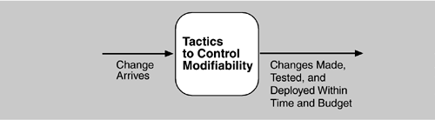
Modifiability …
Goal of Modifiability Tactics
  Tactics to control modifiability- control complexity of making changes, time and cost to make changes.

Slide 31
Modifiability …
Goal of Modifiability Tactics …
  Reduce Size of a Module- split module:
    if the module being modified has high capability, costs will be high- several smaller ones reduce cost of change.
  Increase Cohesion- Increase Semantic Coherence:
    if responsibilities A and B in a module do not serve the same purpose, they should be placed in different modules.
  Defer Binding
    In general, binding values later in the life cycle is better.
    artifacts designed with built-in flexibility are usually cheaper than hand-coding a specific change.
    However, putting the mechanisms in place to facilitate that late binding tends to be more expensive.

Slide 32
Modifiability …
Goal of Modifiability Tactics …
  Reduce Coupling
    Encapsulate: introduces an explicit interface to a module- make API and responsibilities, e.g., perform a syntactic transformation on an input parameter to an internal representation.”
    Use an Intermediary: Given a dependency like responsibility A then B, it can be broken by using an intermediary.
    Restrict Dependencies: which a given module interacts/depends.
    Refactor: undertaken when two modules are affected by the same change because they are (at least partial) duplicates of each other.
    Abstract Common Services: where two modules provide not-quite-the-same but similar services, it may be cost-effective to implement the services just once in a generic form.

Slide 33
Performance
What is Performance?
  It is about system’s ability to meet time requirements.
  When events like interrupts and requests from users occur, the system must respond to them in time.
  Characterizing the events that can occur (when) and the system’s time-based response to those events is the essence is discussing performance.
  Sample concrete performance scenario
  Users initiate transactions under normal operations. The system processes the transactions with an average latency of two seconds.

Slide 34
Performance …
General Scenario
Portion of Scenario | Possible Values
Source | Internal or external to the system
Stimulus | Arrival of a periodic, sporadic, or stochastic event
Artifact | System or one or more components in the system.
Environment | Operational mode: normal, emergency, peak load, overload.
Response | Process events, change level of service
Response Measure | Latency, deadline, throughput, jitter, miss rate

Slide 35
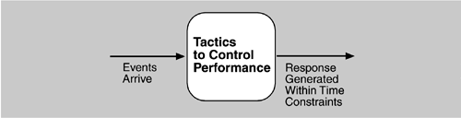
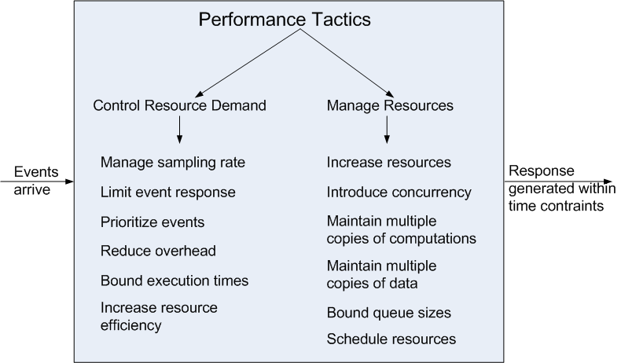
Performance …
Goal of Performance Tactics
  Tactics to control Performance- the goal is to generate response to event within some time-based constraint.

Slide 36
Performance …
Goal of Performance Tactics …
  Control Resource Demand
    Manage Sampling Rate: reducing sampling frequency of stream of data is captured can reduce the demand with some loss of fidelity.
    Limit Event Response: process events only up to a set maximum rate, thereby ensure predictable processing of the events.
    Prioritize Events: impose a priority scheme that ranks events according to how important it is to service them.
    Reduce Overhead: The use of intermediaries (for modifiability) increases resources consumed - removing them improves latency.
    Bound Execution Times: limit execution time when responding.
    Increase Resource Efficiency: improving the algorithms used in critical areas will decrease latency.

Slide 37
Performance …
Goal of Performance Tactics …
  Manage Resources
    Increase Resources: Faster/additional processors, more memory, and faster networks all have the potential for reducing latency.
    Increase Concurrency: If requests can be processed in parallel, the blocked time can be reduced- processing different streams of events on different threads.
    Maintain Multiple Copies of Computations: replicas reduce the contention when all computations took place on a single server.
    Maintain Multiple Copies of Data: keeping copies of data on storage with different access speeds.
    Bound Queue Sizes: control maximum number of queued arrivals and consequently the resources used to process the arrivals.
    Schedule Resources: … when there is contention for a resource.

Slide 38
Security
What is Security?
  is a measure of system’s ability to protect data and information from unauthorized access while still providing access to authorized people and systems.
  action taken against a system with harm intention is called an attack and can take several forms.
  includes unauthorized attempt to access data/services or to modify or to deny services to legitimate users.

Slide 39
Security …
What is …
  Security has three main characteristics, called CIA:
    Confidentiality is the property that data or services are protected from unauthorized access. For example, a hacker cannot access your income tax returns on a government computer.
    Integrity is the property that data or services are not subject to unauthorized manipulation. For example, your grade has not been changed since your instructor assigned it.
    Availability is the property that the system will be available for legitimate use. For example, a denial-of-service attack won’t prevent you from ordering a book from an online bookstore.
  Other characteristics that support CIA are
    Authentication verifies the identities of the parties to a transaction and checks if they are truly who they claim to be. For example, when you get an e-mail purporting to come from a bank, authentication guarantees that it actually comes from the bank.
    Nonrepudiation guarantees that the sender of a message cannot later deny having sent the message and that recipient cannot deny having received the message. For example, you cannot deny ordering something from Internet, or the merchant cannot disclaim getting your order.
    Authorization grants a user the privileges to perform a task. For example, an online banking system authorizes a legitimate user to access his account.
  Sample Concrete Security Scenario
    A disgruntled employee from a remote location attempts to modify the pay rate table during normal operations. The system maintains an audit trail and the correct data is restored within a day.

Slide 40
Security …
General Scenario
Portion of Scenario | Possible Values
Source | Human or another system which may have been previously identified (either correctly or incorrectly) or may be currently unknown. A human attacker may be from outside the organization or from inside the organization.
Stimulus | Unauthorized attempt is made to display data, change or delete data, access system services, change the system’s behavior, or reduce availability.
Artifact | System services; data within the system; a component or resources of the system; data produced or consumed by the system
Environment | The system is either online or offline, connected to or disconnected from a network, behind a firewall or open to a network, fully operational, partially operational, or not operational
Response | Transactions are carried out in a fashion such that data or services are protected from unauthorized access; data or services are not being manipulated without authorization; parties to a transaction are identified with assurance; the parties to the transaction cannot repudiate their involvements; the data, resources, and system services will be available for legitimate use. The system tracks activities within it by recording access or modification, recording attempts to access data, resources or services, notifying appropriate entities (people or systems) when an apparent attack is occurring.
Response Measure | One or more of the following how much of a system is compromised when a particular component or data value is compromised, how much time passed before an attack was detected, how many attacks were resisted, how long does it take to recover from a successful attack, how much data is vulnerable to a particular attack

Slide 41
Security …
Goal of Security Tactics
  physical security is one method of security.
    secure installations have limited access to them (e.g., by using security checkpoints),
    have means of detecting intruders (e.g., by requiring legitimate visitors to wear badges),
    have deterrence mechanisms such as armed guards,
    have reaction mechanisms such as automatic locking of doors, and
    have recovery mechanisms such as off-site back up.
  four categories of tactics: detect, resist, react, and recover.

Slide 42
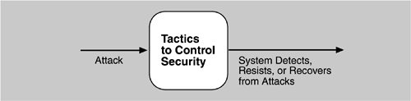
Security …
Goal of Security Tactics …

Slide 43
Security …
Goal of Security Tactics …
  Detect Attacks
    Detect Intrusion: compare network traffic or request patterns within a system to signatures- known patterns of malicious behavior stored in a database.
    Detect Service Denial: comparison of the pattern of network traffic coming into a system to historic profiles of known DoS attacks.
    Verify Message Integrity: techniques like checksums or hash values to verify the integrity of messages and files(resources, deployments, configurations).
    Detect Message Delay: checking the time that it takes to deliver a message, it is possible to detect suspicious timing behavior.

Slide 44
Security …
Goal of Security Tactics …
  Resist Attacks
    Identify Actors: identify the source of any external input to the system.
    Authenticate Actors: ensure that an actor (user or a remote computer) is who or what it purports to be.
    Authorize Actors: ensuring that an authenticated actor has the rights to access and modify either data or services.
    Limit Access: limiting access to resources such as memory, network connections, or access points.
    Limit Exposure: minimize the attack surface of a system by having the fewest possible number of access points.
    Encrypt Data: apply some form of encryption to data and to communication.
    Separate Entities: can be done through physical separation on different servers attached to different networks, use of virtual machines.
    Change Default Settings: Force user to change settings assigned by default.

Slide 45
Security …
Goal of Security Tactics …
  React to Attacks
    Revoke Access: limit access to sensitive resources, even for normally legitimate users and uses, if an attack is suspected.
    Lock Computer: limit access to a resource if there are repeated failed attempts to access it.
    Inform Actors: notify operators, other personnel, or cooperating systems when an attack is suspected or detected.
  Recover From Attacks
    In addition to the availability tactics for recovery of failed resources, there is Audit.
    Audit keeps a record of user and system actions and their effects, to help trace actions of, and to identify, an attacker.

Slide 46
Testability
What is Testability?
  It refers to the ease with which software can be made to demonstrate its faults through (execution-based) testing.
  Specifically, it is probability of failing on its next test execution.
  If a fault is present in a system, then we want it to fail during testing as quickly as possible.
  For a system to be testable, it must be possible to control each component’s inputs and then to observe its outputs.
  Sample concrete testability scenario:
  The unit tester completes a code unit during development and performs a test sequence whose results are captured and that gives 85% path coverage within 3 hours of testing.

Slide 47
Testability …
General Scenario
Portion of Scenario | Possible Values
Source | Unit testers, integration testers, system testers, acceptance testers, end users, either running tests manually or using automated testing tools
Stimulus | A set of tests are executed due to the completion of a coding increment such as a class, layer or service; the completed integration of a subsystem; the complete implementation of the system; or the delivery of the system to the customer.
Environment | Design time, development time, compile time, integration time, deployment time, run time
Artifacts | The portion of the system being tested
Response | One or more of the following: execute test suite and capture results; capture activity that resulted in the fault; control and monitor the state of the system
Response Measure | One or more of the following: effort to find a fault or class of faults, effort to achieve a given percentage of state space coverage; probability of fault being revealed by the next test; time to perform tests; effort to detect faults; length of longest dependency chain in test; length of time to prepare test environment; reduction in risk exposure (size(loss) * prob(loss))

Slide 48
Testability …
Goal of Testability Tactics
  the goal is to allow easier testing when increment of software development has completed.
  anything the architect can do to reduce the high cost of testing will yield a significant benefit.
  There are two categories of tactics for testability:
    first category deals with adding controllability and observability to the system.
    second deals with limiting complexity in system’s design.

Slide 49
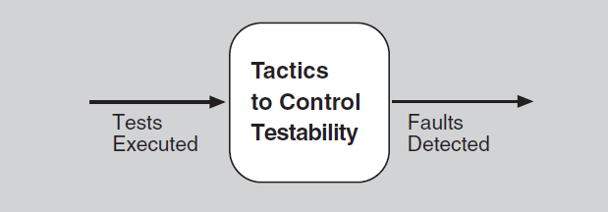
Testability …
Goal of Testability Tactics …

Slide 50
Testability …
Goal of Testability Tactics …
  Control and Observe System State
    Specialized Interfaces: to control variable values for a component either through a test harness or through normal execution.
    Record/Playback: capturing information crossing an interface and using it as input for further testing.
    Localize State Storage: starting a system in arbitrary state for a test, it is most convenient if that state is stored in a single place.
    Abstract Data Sources: abstracting the interfaces lets you substitute test data more easily.
    Sandbox: isolate the system from real world- experiment testing unconstrained by the worry to undo the consequences.
    Executable Assertions: assertions are hand coded and placed at locations to indicate when/where a program is in a faulty state.

Slide 51
Testability …
Goal of Testability Tactics …
  Limit Complexity
    Limit Structural Complexity: resolving cyclic dependency between components, isolating it on external environment, and reducing dependency between components in general.
    Limit Non-determinism: find sources of non-determinism, like unconstrained parallelism, and weeding them out.

Slide 52
Usability
What is Usability?
  it is concerned with how easy it is for the user to accomplish a desired task and the kind of user support the system provides.
  it is one of the cheapest and easiest ways to improve a system’s quality (user’s perception of quality).
Usability comprises the following areas:
  learning system features.
  using a system efficiently.
  minimizing the impact of errors.
  adapting the system to user needs.
  increasing confidence and satisfaction.
  Sample concrete usability scenario:
  The user downloads a new application and is using it productively after two minutes of experimentation.

Slide 53
Usability …
General Scenario
Portion of Scenario | Possible Values
Source | End user, possibly in a specialized role
Stimulus | End user tries to use a system efficiently, learn to use the system, minimize the impact of errors, adapt the system, or configure the system
Environment | Runtime or configuration time
Artifacts | System or the specific portion of the system with which the user is interacting.
Response | The system should either provide the user with the features needed or anticipate the user’s needs.
Response Measure | One or more of the following: task time, number of errors, number of tasks accomplished, user satisfaction, gain of user knowledge, ratio of successful operations to total operations, or amount of time or data lost when an error occurs.

Slide 54
Usability …
Goal of Usability Tactics
  in HCI, user (system or mixed) initiatives are used to describe which takes the initiative to perform actions and how interaction proceeds.
  usability scenarios combine from both perspectives.
  this distinction is used to discuss the tactics that the architect uses to achieve the various scenarios.

Slide 55
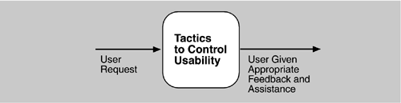
Usability …
Goal of Usability Tactics …

Slide 56
Usability …
Goal of Usability Tactics …
  Support User Initiative
    Cancel: the system must listen for cancel request; command being canceled must be terminated; resources used must be freed; and collaborating components must be informed.
    Pause/Resume: temporarily free resources to allocate to other tasks.
    Undo: maintain enough information about system state so that an earlier state may be restored, at the user’s request.
    Aggregate: ability to aggregate lower-level objects into a group, so that a user operation may be applied to the group, freeing user from drudgery.

Slide 57
Usability …
Goal of Usability Tactics …
  Support System Initiative
    Maintain Task Model: determines context so the system can have some idea of what the user is attempting and provide assistance.
    Maintain User Model: explicitly represents the user's knowledge of the system, the user's behavior in terms of expected response time, etc.
    Maintain System Model: system maintains an explicit model of itself to determine expected system behavior and give feedback to the user.

Slide 58
Other Quality Attributes
Quality Attributes
  Variability: a special form of modifiability which refers to the ability of a system to support the production of variants in a preplanned fashion.
  Portability: special form of modifiability- refers to the ease of changing software to run on a different platform than one it is built to run on.
  Development Distributability: is the quality of designing the software to support distributed development.
  Scalability: horizontal (scaling out) is to add more resources such as adding servers to a cluster while vertical (scaling up) is adding more resources to a physical unit such as adding more memory to a computer.
  Deployability: how executable arrives at a host platform, and it is invoked.
  Mobility: deals with the problems of movement and affordances of a platform (e.g. size, type of display, type of input devices, volume of bandwidth, and battery life).

Slide 59
Other Quality Attributes …
Quality Attributes …
  Monitorability: ability of operations staff to monitor system while executing.
  Safety: ability to avoid entering states that cause damage, injury, or loss of life and recover/limit the damage- architectural concerns are just like availability (i.e., preventing, detecting, and recovering from failures).
  Conceptual Integrity: consistency in the design of the architecture (and its understandability) which demands same thing to be done same way.
  Marketability: architectures sometimes carry a marketable meaning, independent of their quality attributes (e.g., service-oriented or cloud-based).
  Quality in Use: qualities pertaining the use of system by stakeholders like:
    Effectiveness: a measure whether the system is correct
    Efficiency: the effort and time required to develop a system
    Freedom from risk: system’s affect to economy, human life/health or environment

Slide 60
Other Quality Attributes …
Software and System Quality Attributes
  implies physical systems such as aircraft or kitchen appliances or automobiles
  such systems rely on software embedded designed to meet a whole other litany of quality attributes:
    weight, size, electric consumption, power output, pollution output, weather resistance, battery life, and on and on.
  software architecture can have a substantial effect on the system’s quality attributes.

Slide 61
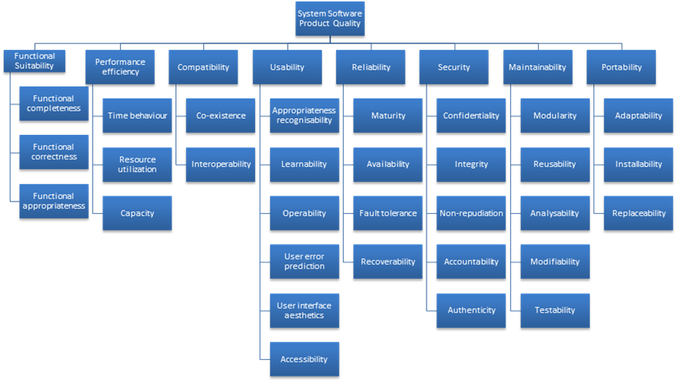
Other Quality Attributes …
ISO/IEC FCD 25010
Product Quality Standard – A List

Slide 62
Other Quality Attributes …
Standard Lists of Quality Attributes
  Advantages:
    Can be helpful checklists to assist requirements gatherers in making sure that no important needs were overlooked.
    Can serve as the basis for creating your own checklist containing quality attributes of concern in various domains …
  Disadvantages:
    No list will ever be complete; lists often generate more controversy than understanding, just taxonomies.
    force architects to pay attention to every quality attribute on the list, even if irrelevant to their system.

Slide 63
Other Quality Attributes …
Dealing with “X-ability”
  if you must deal with quality attribute where no compact body of knowledge, e.g., green computing.
  The following can be performed:
    Model the quality attribute
    Assemble a set of tactics for the quality attribute
    Construct design checklists

